Slide 1
Why “ecological forecasting”?
Amy Hurford
Memorial University

Slide 2

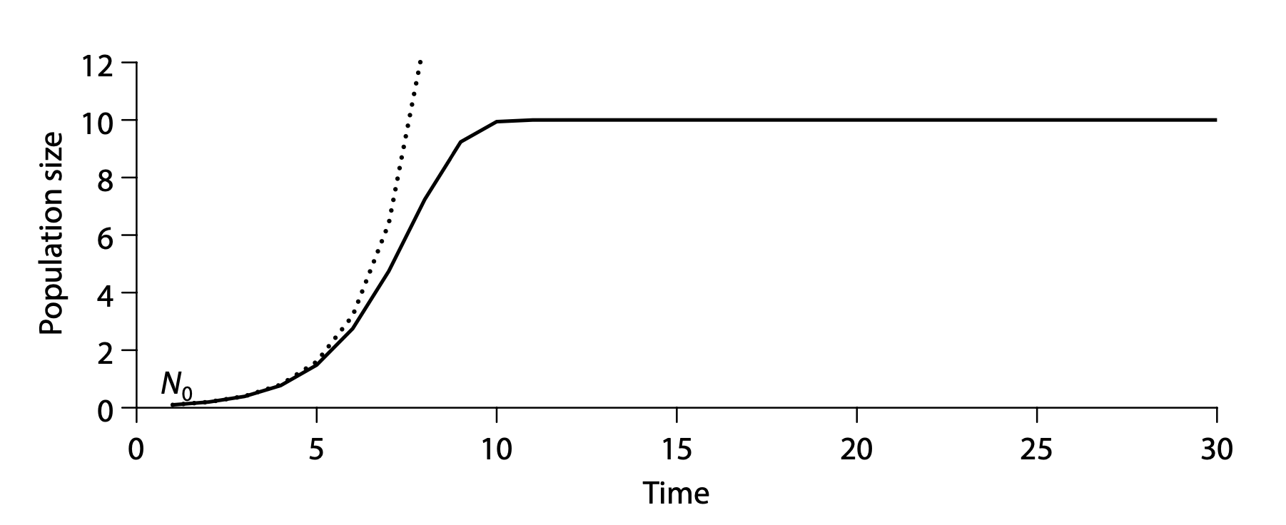
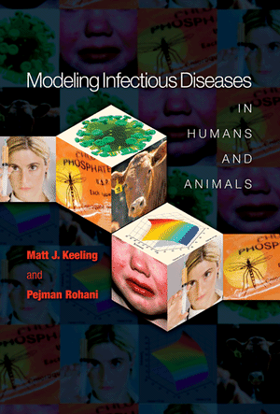
Population biology, deterministic dynamical systems, mechanistic models
Dietz 2017. Ecological forecasting. Ch 2.

Slide 3
Simple parameterization approach
r = b – d
b: births per individual per time step
d: fraction of the population that dies per time step

Slide 4
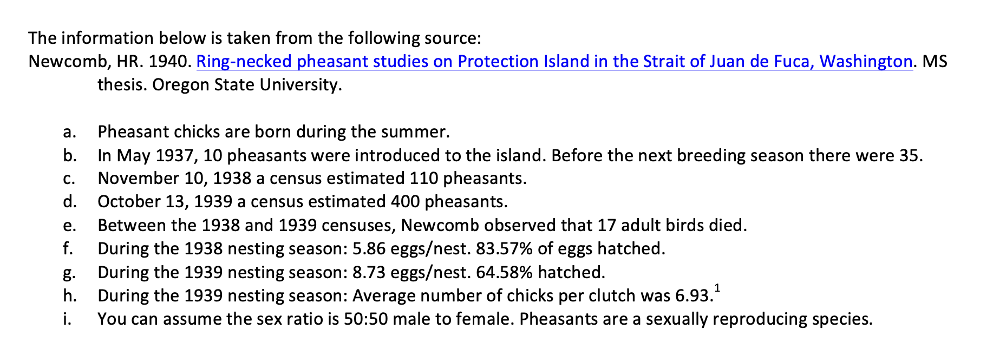
Simple parameterization approach

Slide 5
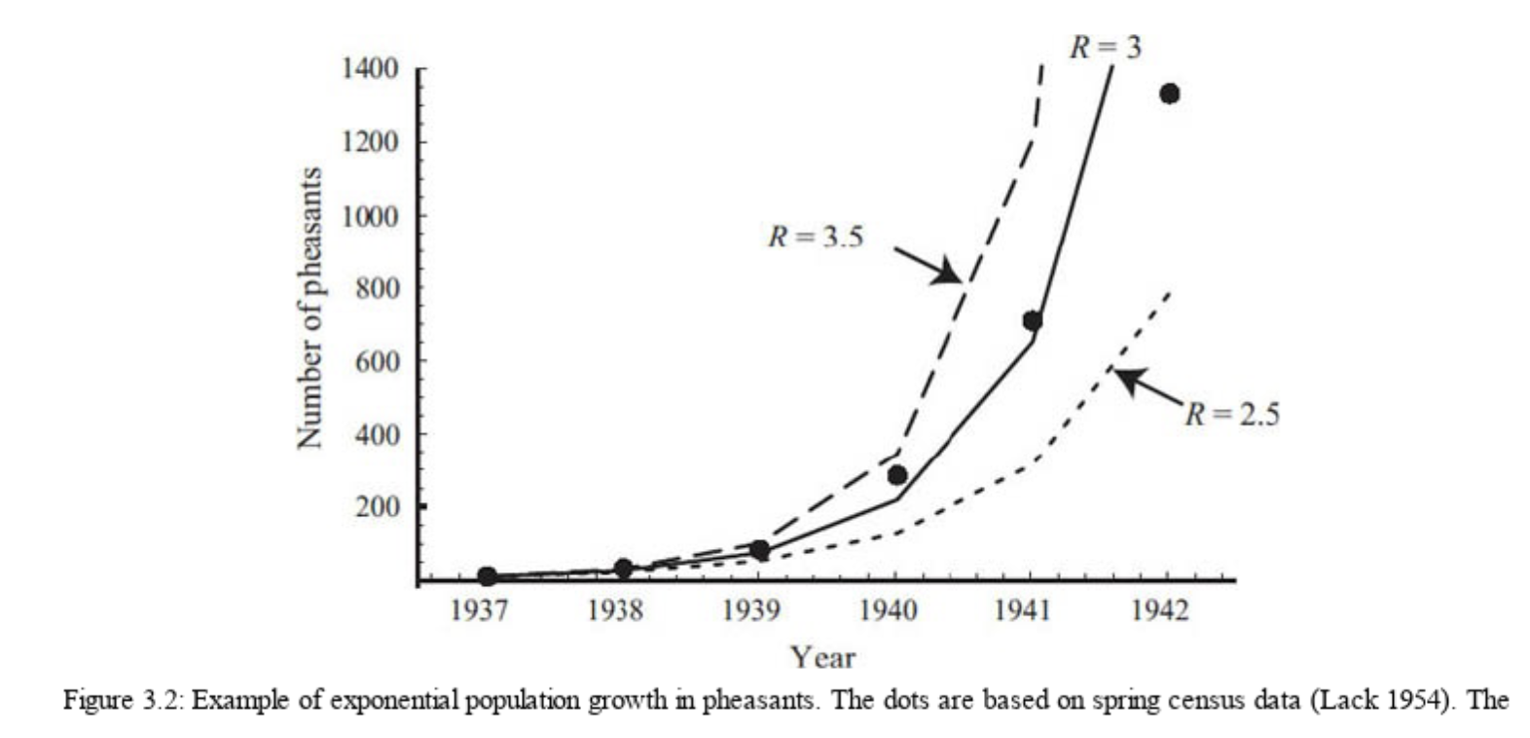
Simple parameterization approach
Otto & Day 2007. A biologists guide to mathematical modelling.

Slide 6
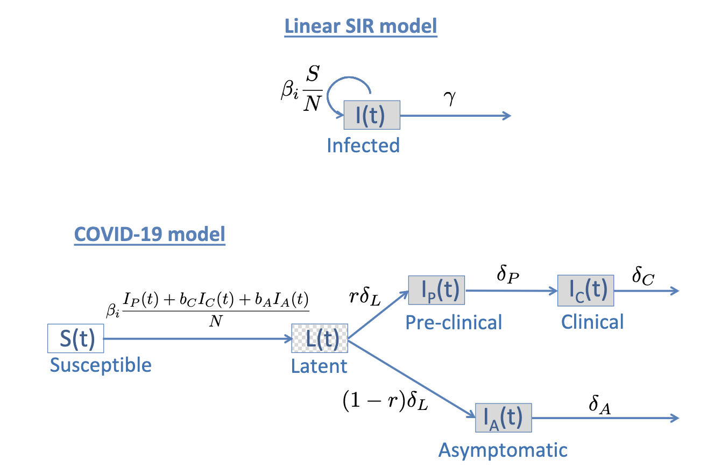
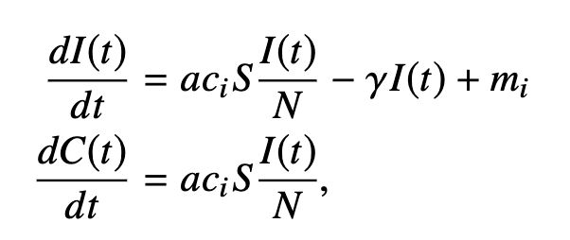
Simple parameterization approach
Hurford & Watmough. 2021. Don’t wait; re-escalate: delayed action results in longer duration of COVID-19 restrictions.

Slide 7
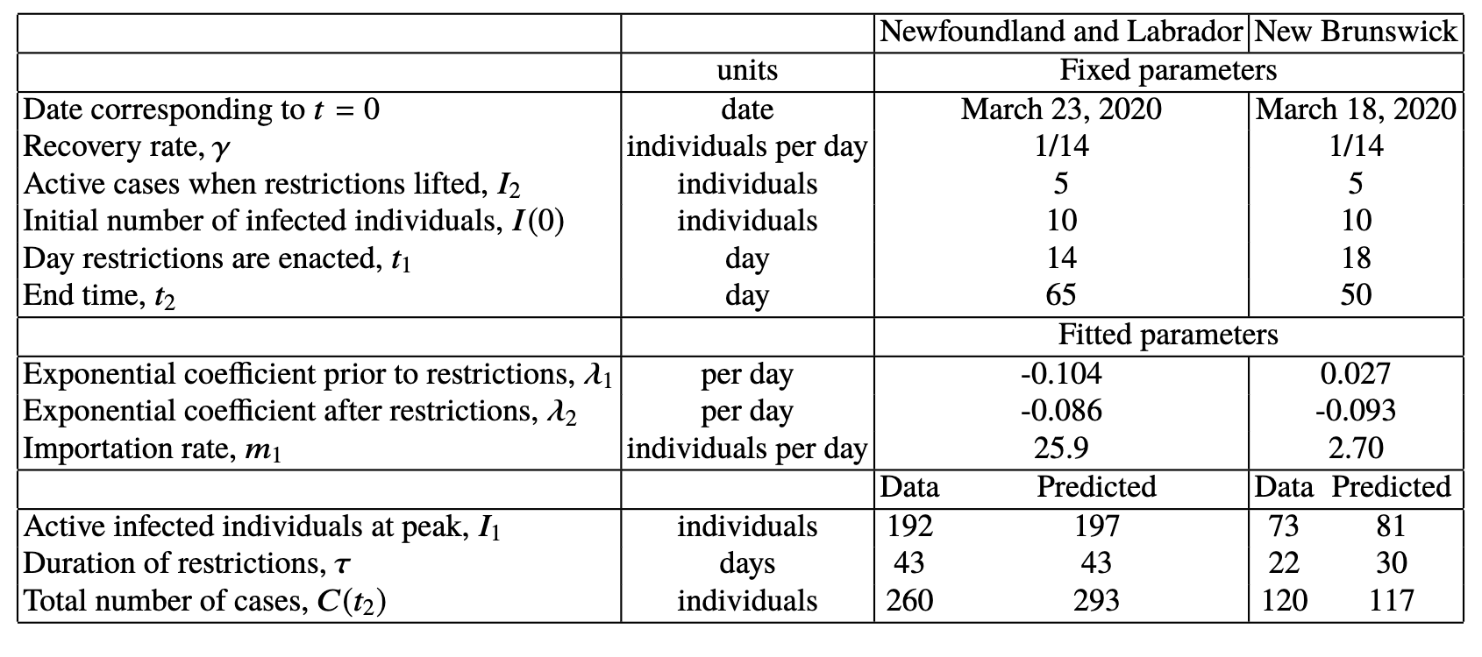
Simple parameterization approach
Hurford & Watmough. 2021. Don’t wait; re-escalate: delayed action results in longer duration of COVID-19 restrictions.

Slide 8
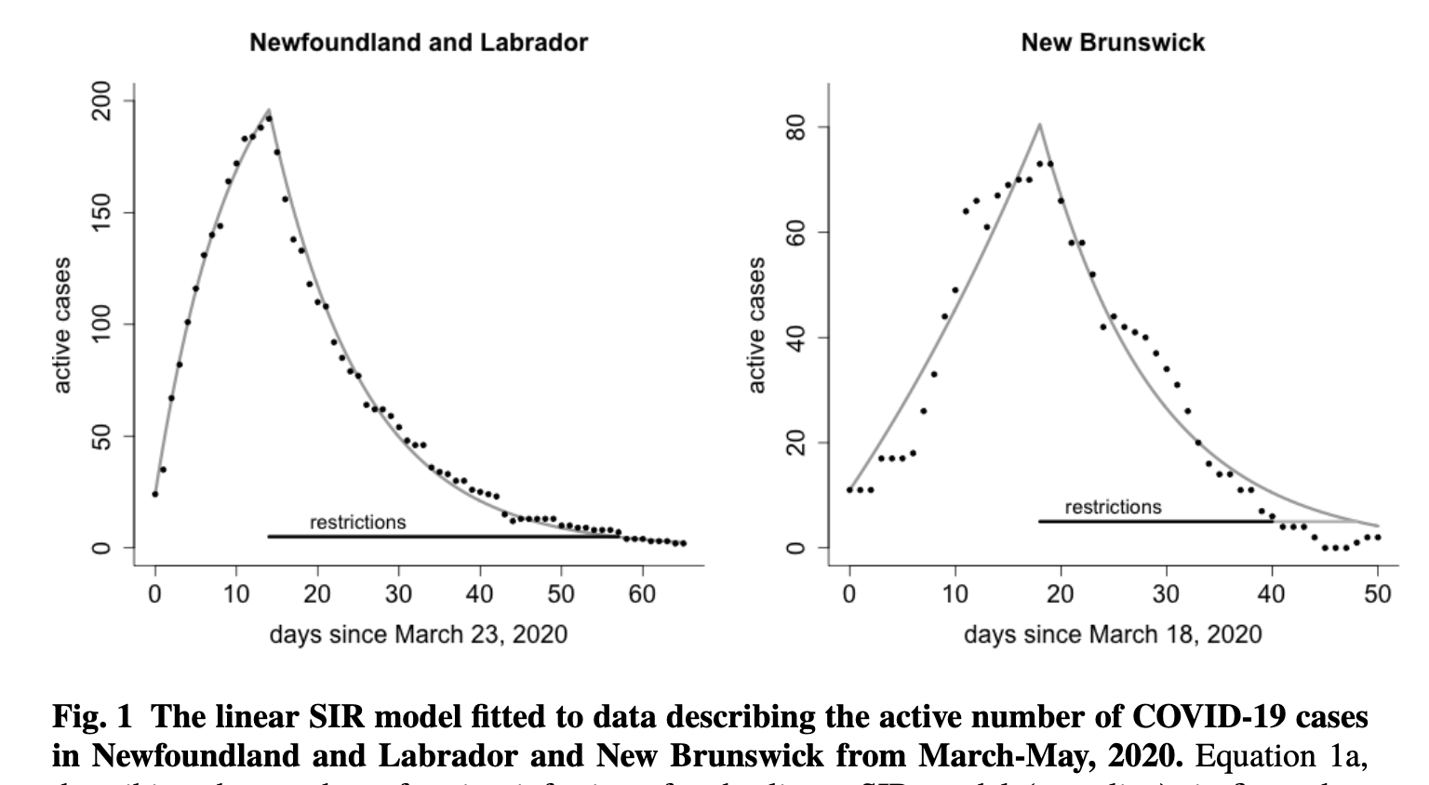
Simple parameterization approach
Hurford & Watmough. 2021. Don’t wait; re-escalate: delayed action results in longer duration of COVID-19 restrictions.

Slide 9
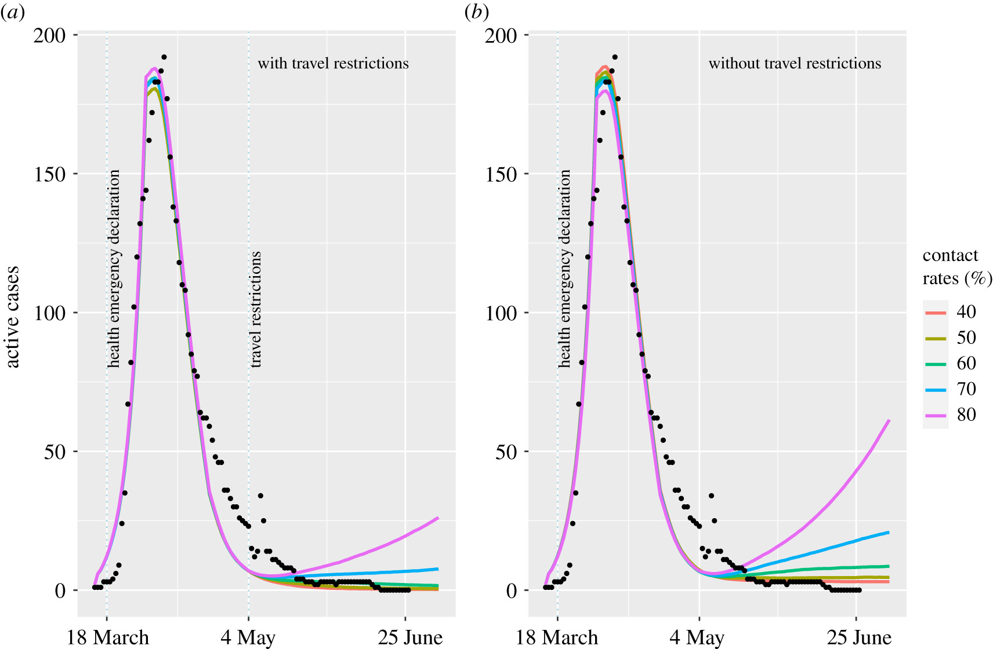
Simple parameterization approach
Hurford et al. 2021. Modelling the impact of travel restrictions on COVID-19 cases in Newfoundland and Labrador

Slide 10
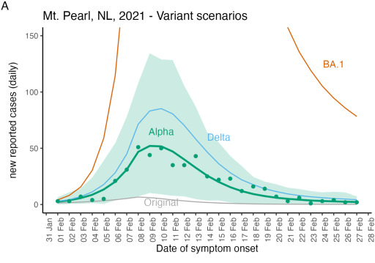
Simple parameterization approach
Hurford et al. 2023. Pandemic modelling for regions implementing an elimination strategy

Slide 11
Simple parameterization approach
Search the literature for 1 value or average
Not rigorous
No or limited treatment of uncertainty in forecasts
Some error sources overlooked, falsely confident predictions
Does not fit data
Disconnected from statistics

Slide 12
Sensitivity analysis

Slide 13
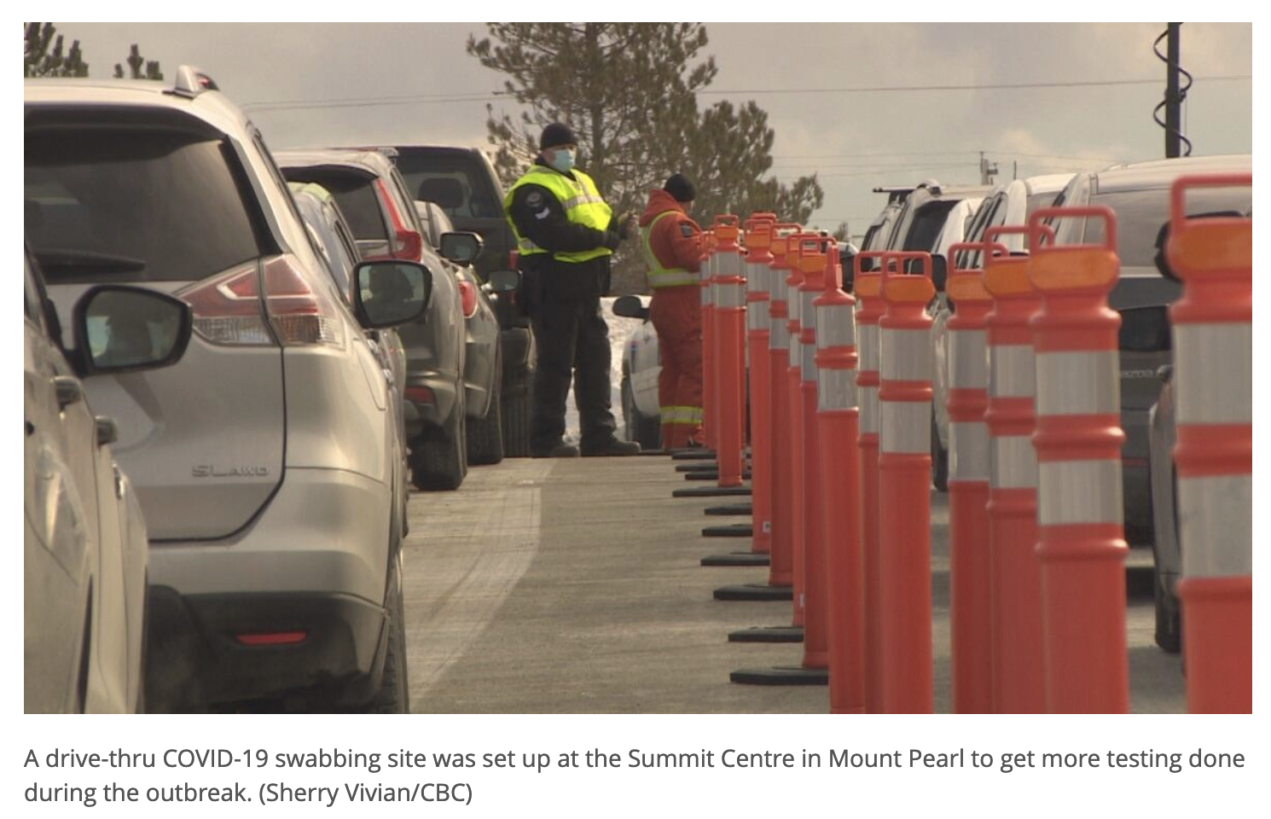
Sensitivity analysis
https://www.cbc.ca/news/canada/newfoundland-labrador/nl-covid-schools-1.5926436

Slide 14
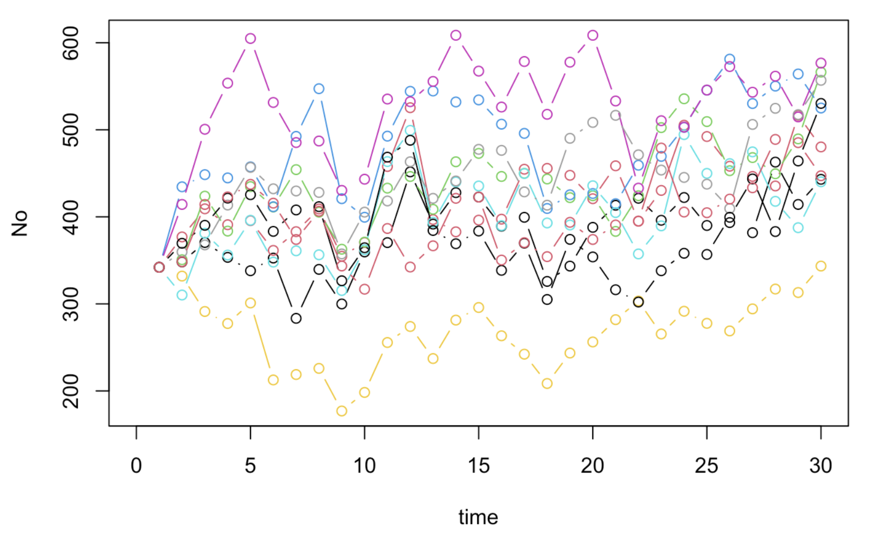
Ecological forecasting
Observed population size, No[s,t]
s: site
t: time
Dietz 2017. Ecological forecasting.
Ch17_Uncertainty_Analysis.Rmd

Slide 15
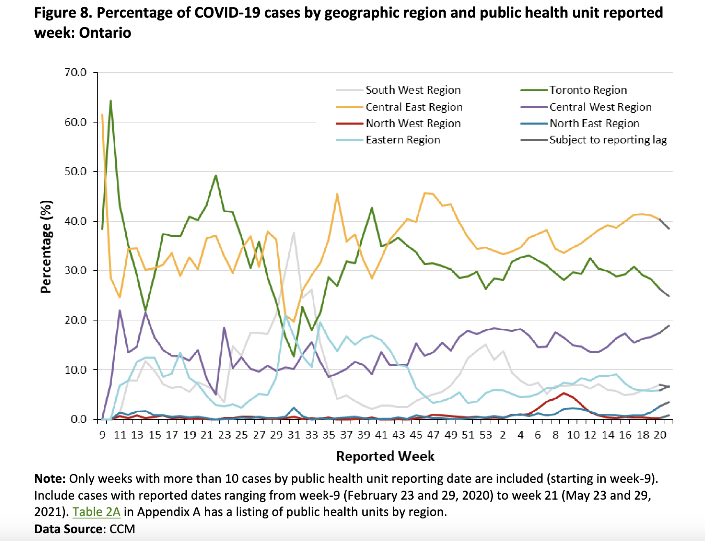
COVID-19 cases by geographic region
Weekly epidemiological summary. COVID-19 in Ontario: Focus on May 23, 2021 to
May 29, 2021. Public Health Ontario. link

Slide 16
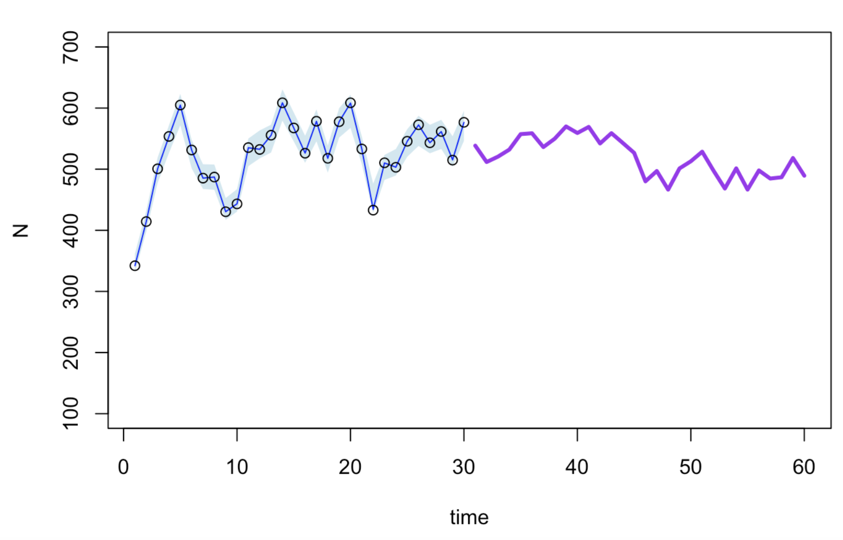
Deterministic forecast for site, s=6
Process model
Random effect, driver (precipitation)
Dietz 2017. Ecological forecasting.
Ch17_Uncertainty_Analysis.Rmd

Slide 17
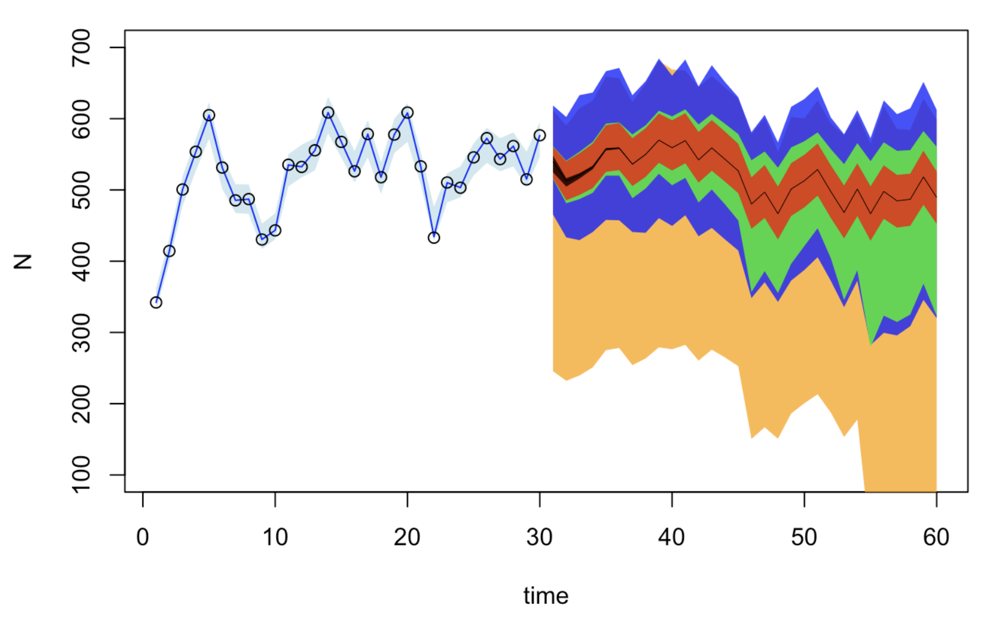
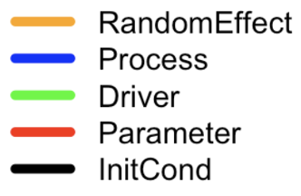
Sources of uncertainty
Dietz 2017. Ecological forecasting.
Ch17_Uncertainty_Analysis.Rmd

Slide 18
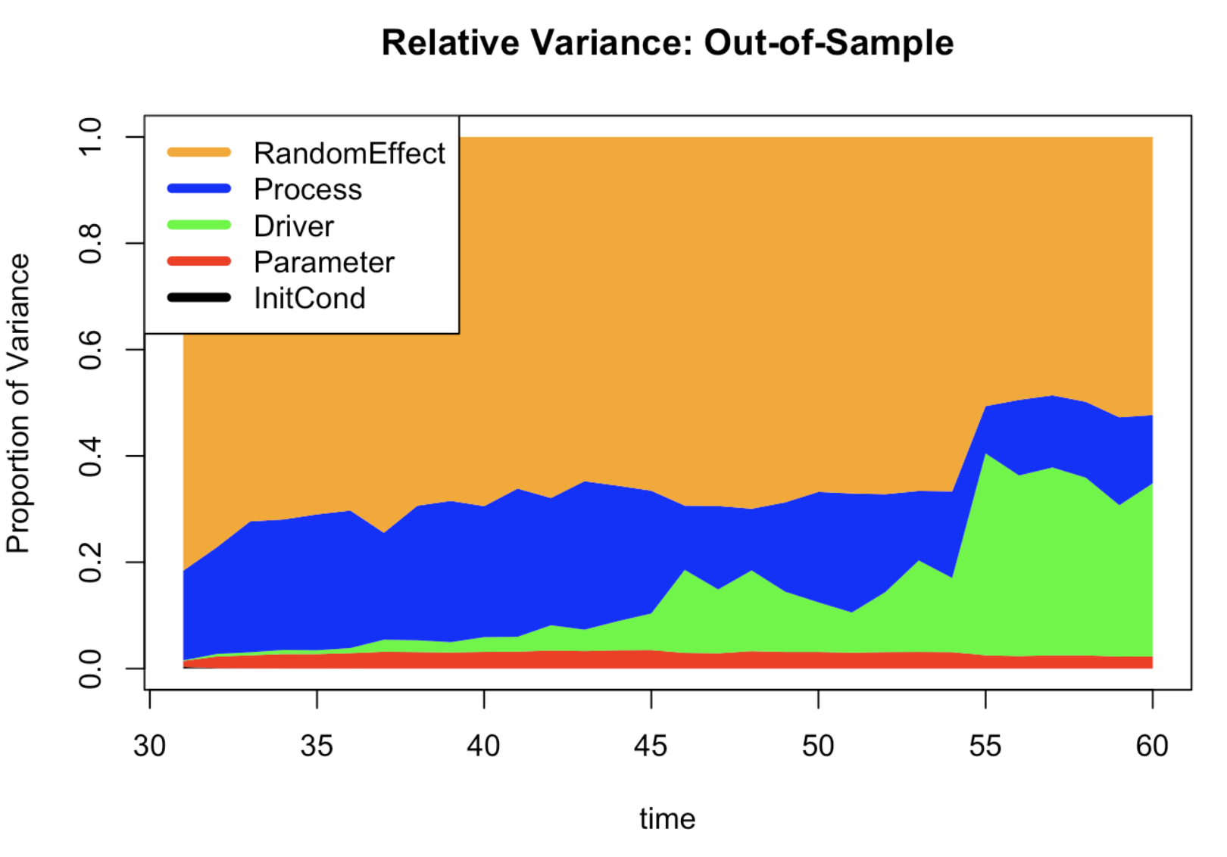
Sources of uncertainty
Dietz 2017. Ecological forecasting.
Ch17_Uncertainty_Analysis.Rmd

Slide 19
Process-based vs. fit data
Mechanistic
epidemiological
Phenomenological
Machine learning
Statistical
The argument for process-based:
Decision-makers need a justification based on a process
Parameters have a meaning, useful derived data products
Out-of-sample prediction
Counterfactual

Slide 20
Schedule
Chapter 6: Characterizing uncertainty (Tuesday PM)
Chapter 8: Latent and state-space models (Wednesday PM)
Chapter 9: Fusing data sources (Wednesday PM)
Chapter 11: Propagating uncertainty (Thursday PM)

